Slide 1
MIPS
Instruction Set Architecture

Slide 2
Introduction
Hardware
Voltages
Logic Gates
Latches
Flip-Flops
Registers
Adders
Arithmetic Logic Unit

Slide 3
Introduction
Hardware Languages
Instruction Sets
MIPS Assembly Language
Machine Code
Binary
Hexadecimal

Slide 4
Instruction Set
Instructions: the words of a computer language
Instruction set: vocabulary
Repertoire of instructions of a computer
Instruction sets may differ from computer to computer, but have many things in common.
Computational operations
Memory access & addressing
Branches
Procedure calls

Slide 5
MIPS Instruction Set
All instruction sets promote a common goal.
Make it easy to build the hardware and the compiler while maximizing performance and minimizing cost.
MIPS is a popular instruction set and has large share of the embedded core market

Slide 6
Arithmetic Operations
Addition
add a, b, c
a = b + c

Slide 7
Arithmetic Operations
Each instruction performs only one operation.
Each instruction must have three variables.
Two sources and one destination.

Slide 8
Arithmetic Operations
a = b + c + d + e
add a, b, c #a = b + c
add a, a, d #a = b + c + d add a, a, e #a = b + c + d + e

Slide 9
Arithmetic Operations
Each line can only have one instruction on it
Anything following a # is a comment.

Slide 10
Arithmetic Operations
From C to MIPS
a = b + c; d = a – e;
add a, b, c sub d, a, e

Slide 11
Arithmetic Operations
From C to MIPS
f = (g + h) – (i + j);
add t0, g, h #temporary variable t0 = g + h
add t1, i, j #temporary variable t1 = i + j
sub f, t0, t1 #f = t0 – t1

Slide 12
Operands
Instructions use register operands
Registers
Made from Flip-Flops
Primitive used in hardware design
Register Size
32 bits
Called a “word”
Number of Registers
32 registers in the register file
Use for frequently accessed data
Numbered 0 to 31

Slide 13
Operands
MIPS naming conventions
$0 - $31
$XX
A $ followed by two characters that represent the register
Assembler names
$t0, $t1, …, $t9 for temporary values
$s0, $s1, …, $s7 for saved variables

Slide 14
Arithmetic Operations
From C to MIPS
f = (g + h) – (i + j);
f g h i j $s0 $s1 $s2 $s3 $s4
add $t0, $s1, $s2 #temporary variable t0 = g + h
add $t1, $s3, $s4 #temporary variable t1 = i + j
sub $s0, $t0, $t1 #f = t0 – t1

Slide 15
Memory Operands
Simple variables
Integers, Characters, etc.
Data Structures
Arrays, Structures
Store data structures in main memory

Slide 16
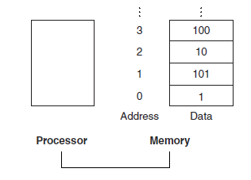
Memory Operands
To use data from main memory:
Load values from memory into registers
Store result from register to memory

Slide 17
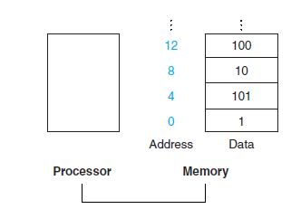
Memory Operands
Memory is byte addressed
Each address identifies an 8-bit byte
Words are aligned in memory
Address must be a multiple of 4

Slide 18
Memory Operands
load
Copies data from memory to a register
store
Copies data from a register to memory

Slide 19
Memory Operands
lw destination, constant(register)
The “load word” instruction takes the sum of the constant and the register to determine a memory address. The data at this address is placed in the destination register.

Slide 20
Memory Operands
From C to MIPS
A is an array of 100 words
g is a variable in $s1
h is a variables in $s2
base address of A is in $s3
g = h + A[8];
First, we have to transfer A[8] to a register.
A[8] is stored in memory address $s3 + 8*4
lw $t0, 32($s3) # t0 = A[8]
add $s1, $s2, $t0 # g = h + A[8]
Offset
Base Register

Slide 21
Memory Operands
sw data, constant(register)
The “store word” instruction takes the sum of the constant and the register to determine a memory address. The data in the first register operand will be placed at this address.

Slide 22
Memory Operands
From C to MIPS
A is an array of 100 words
h is a variables in $s2
base address of A is in $s3
A[12] = h + A[8]
lw $t0, 32($s3) # t0 = A[8]
add $t0, $s2, $t0 # t0 = h + A[8] sw $t0, 48($s3) # store t0 in A[12]

Slide 23
Constant Operands
Sometimes we need to use a constant value
So far, we would need to load the constant into a register
Requires two instructions: load word and add
Instead, the “quick add” instruction allows us to use a constant instead of one of the register operands

Slide 24
Constant Operands
From C to MIPS
s = s + 4
addi $s0, $s0, 4

Slide 25
Representing Instructions
We know that computers use binary to represent data
Register names are also mapped to numbers
8 $t0 16 $s0
9 $t1 17 $s1
10 $t2 18 $s2
11 $t3 19 $s3
12 $t4 20 $s4
13 $t5 21 $s5
14 $t6 22 $s6
15 $t7 23 $s7

Slide 26
Representing Instructions
C Programming Language
fruit = num_apples + num_oranges;
MIPS Assembly
add $s0, $s1, $s2
Machine Code
0000 0010 0011 0010 1000 0000 0010 0000

Slide 27

Representing Instructions
Instruction Format
The layout of an instruction
formed by pieces of the instruction called fields

Slide 28
Representing Instructions
Instruction fields
op: operation code (opcode)
rs: first source register number
rt: second source register number
rd: destination register number
shamt: shift amount (00000 for now)
funct: function code (extends opcode)
op
rs
rt
rd
shamt
funct
6 bits
5 bits
5 bits
5 bits
5 bits
6 bits

Slide 29
Representing Instructions
add $t0, $s1, $s2
Represented using decimal numbers in each field:
Convert each field to binary:
Result:
00000010001100100100000000100000₂
0
17
18
8
0
32
000000
10001
10010
01000
00000
100000

Slide 30
Representing Instructions
Hexadecimal
Instead of writing strings of 32-bit binary numbers, we can use hexadecimal – a base that converts easily into binary.
Hexadecimal is base 16
Uses digits 0-9, A-F
Replaces a group of four binary numbers with a single hexadecimal digit
0 | 0000 | 4 | 0100 | 8 | 1000 | C | 1100
1 | 0001 | 5 | 0101 | 9 | 1001 | D | 1101
2 | 0010 | 6 | 0110 | A | 1010 | E | 1110
3 | 0011 | 7 | 0111 | B | 1011 | F | 1111

Slide 31
Representing Instructions
add $t0, $s1, $s2
00000010001100100100000000100000₂
0000 0010 0011 0010 0100 0000 0010 0000
0 2 3 2 4 0 2 0
0x02324020

Slide 32
Representing Instructions
Convert from hexadecimal to binary:
0xECA86420
E C A 8 6 4 2 0
1110 1100 1010 1000 0110 0100 0010 0000

Slide 33
Instruction Formats
What if we need longer fields?
The load word instruction specifies two registers and a constant.
With our current fields, the constant is restricted to 5 or 6 bits
Same size for all instructions vs. Same format for all instructions
op
rs
rt
rd
shamt
funct
6 bits
5 bits
5 bits
5 bits
5 bits
6 bits

Slide 34
Instruction Formats
R-type
I-type
J-type
op
rs
rt
rd
shamt
funct
6 bits
5 bits
5 bits
5 bits
5 bits
6 bits
op
rs
rt
constant or address
6 bits
5 bits
5 bits
16 bits
op
address
6 bits
26 bits

Slide 35
Instruction Formats
I-type
A 16 bit address allows:
lw and sw to access a range of 8192 words
addi to add constants in a range of +/- 215
op
rs
rt
constant or address
6 bits
5 bits
5 bits
16 bits

Slide 36
Instruction Formats
lw $t0, 32($s3)
Represented using decimal:
35 19 8 32
Represented in binary:
100011 10011 01000 0000000000100000
1000 1110 0110 1000 0000 0000 0010 0000
Represented in hexadecimal:
0x8E680020
op
rs
rt
constant or address
6 bits
5 bits
5 bits
16 bits

Slide 37
Instruction Formats
Different formats complicate decoding, but allow 32-bit instructions uniformly
Keep formats as similar as possible
First three fields of R-type and I-type are the same
Fourth field of I-type is the size of the last 3 fields of R-type
The first field (op) determines the type and is the same in all three formats

Slide 38
From C to Machine Code
A[300] = h + A[300];
lw $t0, 1200($t1) #$t1 is the base register
add $t0, $s2, $t0 #$s2 is h
sw $t0, 1200($t1)
35 9 8 1200
0 18 8 8 0 32
43 9 8 1200

Slide 39
From C to Machine Code
A[300] = h + A[300];
lw $t0, 1200($t1) #$t1 is the base register
add $t0, $s2, $t0 #$s2 is h
sw $t0, 1200($t1)
100011 01001 01000 0000010010110000 000000 10010 01000 01000 00000 100000 101011 01001 01000 0000010010110000

Slide 40
Logical Operations
Shifts
Logical Operation | C Operator | MIPS Instruction
Shift Left | << | sll
Shift Right | >> | srl

Slide 41
Shift Operations
op
rs
rt
rd
shamt
funct
shamt: how many positions to shift
Shift left logical
Shift left and fill with 0 bits
sll by i bits multiplies by 2^{i}
Shift right logical
Shift right and fill with 0 bits
srl by i bits divides by 2^{i} (unsigned only)
6 bits
5 bits
5 bits
5 bits
5 bits
6 bits

Slide 42
Shift Operations
0000 0000 0000 00000 000 0000 0000 0000 1001 (9)
Shift left by four:
0000 0000 0000 0000 0000 0000 0000 1001 0000 (144)
9 * 2⁴ = 144

Slide 43
Shift Operations
sll $t2, $s0, 4 # t2 = s0 << 4
R-type instruction that uses the shamt field:
0 0 16 10 4 0

Slide 44
Logical Operations
Logical
Logical Operation | C Operator | MIPS Instruction
Bitwise AND | & | and, andi
Bitwise OR | | | or, ori
Bitwise NOT | ~ | nor

Slide 45
AND
Bit-by-bit operation that leaves 1 in the result only if both bits of the operands are 1.
and $t0, $t1, $t2
Use AND to “mask” some bits in a word.
$t2
0000 0000 0000 0000 0000 1101 1100 0000
$t1
0000 0000 0000 0000 0011 1100 0000 0000
$t0
0000 0000 0000 0000 0000 1100 0000 0000

Slide 46
OR
Bit-by-bit operation that leaves 1 in the result only if either bits of the operands are 1.
or $t0, $t1, $t2
$t2
0000 0000 0000 0000 0000 1101 1100 0000
$t1
0000 0000 0000 0000 0011 1100 0000 0000
$t0
0000 0000 0000 0000 0011 1101 1100 0000

Slide 47
NOT
Bit-by-bit operation on only one operand that inverts each bit: changes a 0 to a 1 and 1 to a 0
NOR
NOT OR
A NOR 0 = NOT (A OR 0) = NOT A

Slide 48
The Constant Zero
MIPS register 0 ($zero) is the constant 0
Cannot be overwritten
Useful for common operations
move between registers
add $t2, $s1, $zero
NOT
nor $t0, $t1, $zero

Slide 49
NOT
nor $t0, $t1, $zero #t0 = ~(t1 | 0)
$t1
0000 0000 0000 0000 0011 1100 0000 0000
$t0
1111 1111 1111 1111 1100 0011 1111 1111

Slide 50
Logical Operations with Constants
and immediate
andi
Or immediate
ori

Slide 51
Branches
Computer programs can make decisions
If statements, Switch statements
Branch to a labeled instruction if a condition is true
Otherwise, continue sequentially
beq rs, rt, L1
if (rs == rt) branch to instruction labeled L1;
bne rs, rt, L1
if (rs != rt) branch to instruction labeled L1;
j L1
unconditional jump to instruction labeled L1

Slide 52
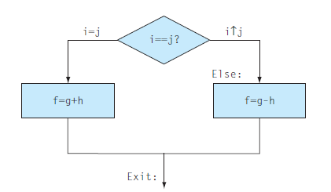
Branches
if (i==j) f = g + h; else f = g - h;
i j f g h
$s0 $s1 $s2 $s3 $s4

Slide 53
Branches
if (i==j) f = g + h; else f = g - h;
i $s0
j $s1
f $s2
g $s3
h $s4
bne $s0,$s1,Else add $s2,$s3,$s4
j Exit
Else: sub $s2,$s3,$s4 Exit:

Slide 54
Loops
Some computer programs require iteration
while loops, for loops

Slide 55
Loops
while (save[i] == k)
i +=1;
Assume i in $s3, k in $s5, base address of save in $s6.
Loop: sll $t1, $s3, 2 add $t1, $t1, $s6 lw $t0, 0($t1) bne $t0, $s5, Exit addi $s3, $s3, 1 j Loop Exit:

Slide 56
More Conditional Operations
Set result to 1 if a condition is true
Otherwise, set to 0
slt rd, rs, rt
if (rs < rt) rd = 1; else rd = 0;
slti rt, rs, constant
if (rs < constant) rt = 1; else rt = 0;
Use in combination with beq, bne
slt $t0, $s1, $s2 # if ($s1 < $s2) bne $t0, $zero, L # branch to L

Slide 57
Branch Instruction Design
Why not blt, bge, etc?
Hardware for <, ≥, … slower than =, ≠
Combining with branch involves more work per instruction, requiring a slower clock
beq and bne are the common case
slt, slti, beq, bne can be used to create any other necessary conditions.
This is a good design compromise

Slide 58
Signed vs. Unsigned
Signed comparison: slt, slti
Unsigned comparison: sltu, sltui
Example
$s0 = 1111 1111 1111 1111 1111 1111 1111 1111
$s1 = 0000 0000 0000 0000 0000 0000 0000 0001
slt $t0, $s0, $s1 # signed
–1 < +1 ⇒ $t0 = 1
sltu $t0, $s0, $s1 # unsigned
+4,294,967,295 > +1 ⇒ $t0 = 0

Slide 59
Switch Statements
switch (selection) {
case 1:
….
case 2:
…
default:
}
if (selection == 1)
goto 1
else if (selection == 2)
goto 2
else
goto 3

Slide 60
Switch Statements
switch (selection) {
case 1:
….
case 2:
…
default:
}
Jump Address Table
selection is an index to the table
the table contains addresses
jr $s0

Slide 61
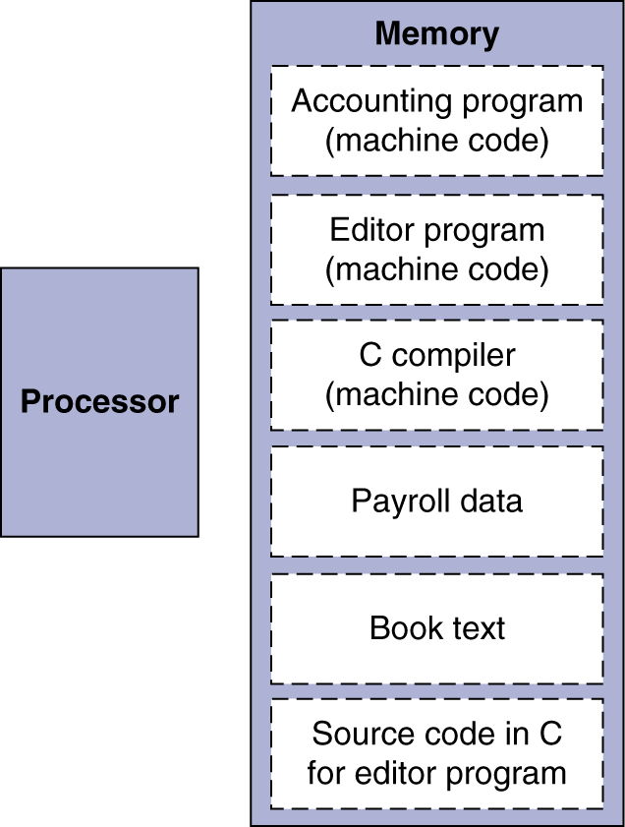
Stored Program Computers
Instructions represented in binary
Instructions and data stored in memory
Programs can operate on programs
e.g., compilers, linkers, …
Binary compatibility allows compiled programs to work on different computers
Standardized ISAs

Slide 62
Procedures
We often write functions or methods
procedures
A procedure is stored subroutine that performs a specific task based on the parameters it is provided

Slide 63
Procedure Calling
Steps required
Place parameters in registers
Transfer control to procedure
Acquire storage for procedure
Perform procedure’s operations
Place result in register for caller
Return to place of call

Slide 64
Registers
$a0-$a3: four argument registers
$v0-$v1: two return value registers
$ra: one return address register

Slide 65
Procedure Call Instructions
Procedure call: jump and link
jal ProcedureLabel
Address of following instruction put in $ra
$ra = PC + 4
Jumps to target address
Procedure return: jump register
jr $ra
Copies $ra to program counter (PC)

Slide 66
Procedures
The parent program (caller) places parameters in $a0-$a3
The caller uses jal to jump to the location of the function being called (callee) and store the return address
The callee completes its task and stores the result in $v0-$v1
The callee returns control with jr $ra

Slide 67
Stacks
What if four argument registers and two return value registers aren’t enough?
Spilling Registers
At the beginning of a procedure the contents of $s0-$s7 can be saved in main memory
The procedure can then use $s0-$s7 normally
At the end, the previous values of $s0-$s7 are retrieved from main memory
Stacks are a natural structure to allocate dynamic data for procedures

Slide 68
Stacks
Stacks are a last-in-first-out structure
Requires a stack pointer to place/remove registers
Adjust the pointer by one word when items are added (pushed) or removed (popped)
MIPS stack pointer is a register: $sp
The “bottom” of the stack is the highest address and the stack “grows” from higher to lower addresses.
Push: write to main memory (at $sp)
decrement $sp
Pop: increment $sp
read from main memory (at $sp)

Slide 69
Leaf Procedure Example
int leaf_example (int g, int h, int i, int j) {
int f;
f = (g+h) – (i+j);
return f;
}
Arguments g - j in $a0 - $a3
f in $s0 (hence, need to save $s0 on stack)
Result in $v0

Slide 70
Leaf Procedure Example
leaf_example:
addi $sp, $sp, -12
sw $t1, 8($sp)
sw $t0, 4($sp)
sw $s0, 0($sp)
add $t0, $a0, $a1
add $t1, $a2, $a3
sub $s0, $t0, $t1
add $v0, $s0, $zero
lw $s0, 0($sp)
lw $t0, 4($sp)
lw $t1, 8($sp)
addi $sp, $sp, 4
jr $ra

Slide 71
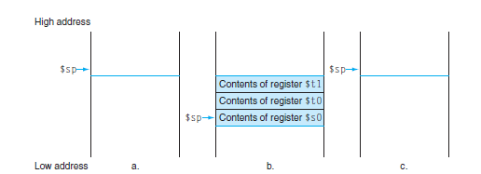
Leaf Procedure Example
To reduce register spilling, we can choose to not save and restore temporary registers.

Slide 72
Leaf Procedure Example
leaf_example: addi $sp, $sp, -4 sw $s0, 0($sp) add $t0, $a0, $a1 add $t1, $a2, $a3 sub $s0, $t0, $t1 add $v0, $s0, $zero lw $s0, 0($sp) addi $sp, $sp, 4 jr $ra

Slide 73
Procedures
Not all procedures are leaf procedures
Procedures call other procedures
Procedures call copies of themselves (recursion)
For nested call, caller needs to save on the stack:
Its return address
Any arguments and temporaries needed after the call
Restore from the stack after the call

Slide 74
Non-Leaf Procedure Example
int fact (int n) { if (n < 1)
return f; else
return n * fact(n - 1);
}
Argument n in $a0
Result in $v0

Slide 75
Non-Leaf Procedure Example
fact:
addi $sp, $sp, -8 # adjust stack for 2 items
sw $ra, 4($sp) # save return address
sw $a0, 0($sp) # save argument
slti $t0, $a0, 1 # test for n < 1
beq $t0, $zero, L1
addi $v0, $zero, 1 # if so, result is 1
addi $sp, $sp, 8 # pop 2 items from stack
jr $ra # and return
L1: addi $a0, $a0, -1 # else decrement n
jal fact # recursive call
lw $a0, 0($sp) # restore original n
lw $ra, 4($sp) # and return address
addi $sp, $sp, 8 # pop 2 items from stack
mult $v0, $a0, $v0 # multiply to get result
jr $ra # and return

Slide 76
Procedures
Preserved | Not Preserved
Saved registers: $s0-$s7 | Temporary registers: $t0-$t9
Stack pointer: $sp | Argument registers: $a0-$a3
Return address: $ra | Return value registers: $v0-$v1
Stack above the stack pointer | Stack below the stack pointer

Slide 77
Stack Frame Layout
Access arguments at
fixed offset from FP. Allow variable number
of arguments.
Higher Addresses
Arguments in reverse order
FP
Saved registers
including
old FP, SP
Access local variables
and saved registers at
fixed (positive) offset
from SP
Local variables
and temporaries
SP
Lower Addresses
Arguments for next procedure

Slide 78
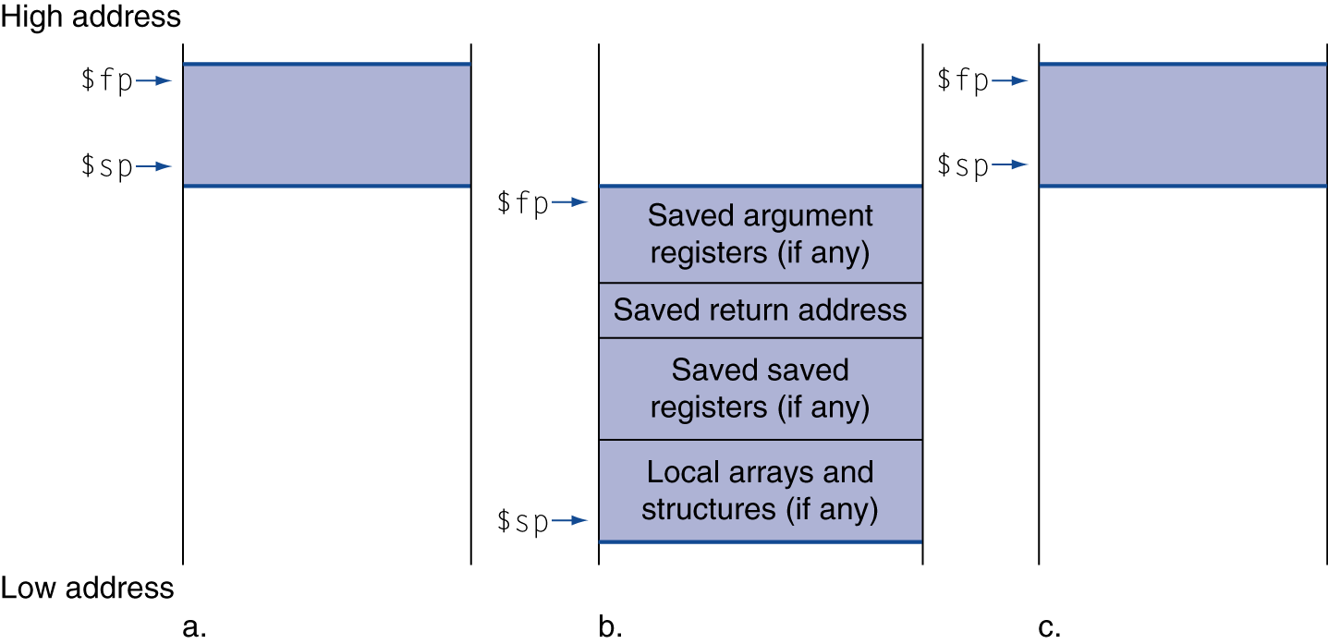
Local Data on the Stack
Local data allocated by callee
Procedure frame (activation record)
Used by some compilers to manage stack storage

Slide 79
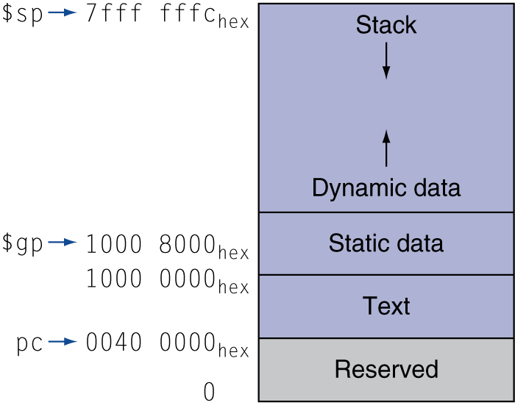
Memory Layout
Text: program code
Static data: global variables
static variables in C
constant arrays and strings
$gp initialized to address allowing ±offsets into this segment
Dynamic data: heap
“malloc” in C
“new” in Java
Stack: automatic storage

Slide 80
MIPS: Software Register Convention
0 $0 zero constant 0
1 $at reserved for assembler
2 $v0 expression evaluation &
3 $v1 function results
4 $a0 arguments (caller saves)
5 $a1
6 $a2
7 $a3
8 $t0 temporary: caller saves
. . .
15 $t7
16 $s0 callee saves
. . .
23 $s7
24 $t8 temporary (cont’d)
25 $t9
26 $k0 reserved for OS kernel
27 $k1
28 $gp global pointer
29 $sp stack pointer
30 $fp frame pointer
31 $ra Return Address

Slide 81
MIPS Register Usage and Saving
The MIPS Architecture Has General-Purpose Registers
the usage for arguments, stack/data/global pointers, preservation, OS-reserved, etc. is a software convention

Slide 82
MIPS Register Usage and Saving
Why are registers partitioned into caller and callee save?
The goal is to minimize the number of registers saved and restored across procedure calls
but at the time a procedure is compiled there is generally incomplete information about register usage by the procedure’s caller and those it calls
if the convention were purely caller save, then the caller would have to save all registers whose value will be used again, even if the callee is a simple leaf procedure that requires only the argument registers
if the convention were purely callee save, then the callee would have to save any register it uses, even if the caller does not need the register’s value
so an efficient compromise is a partition of caller/callee save registers

Slide 83
Characters
Characters are represented in 8-bit bytes
American Standard Code for Information Interchange (ASCII)
128 characters: 95 graphic, 33 control
Latin-1
256 characters: ASCII characters + 96 more graphic characters
Unicode
Variable length: 8 bits (UTF-8), 16 bits (UTF-16), 32 bits
Contains most of the world’s alphabets, plus symbols

Slide 84
Characters
To load a character:
Use load word to retrieve the correct 32 bit word
Use logical instructions to extract the correct byte
MIPS byte instructions
load byte
store byte

Slide 85
Byte Operations
load byte lb rt, offset(rs)
Loads a byte from rs+offset, placing it in the rightmost 8 bits of rt
store byte sb rt, offset(rs)
Stores the rightmost 8 bits of rt in rs+offset
lb $t0,0($sp) # Read byte from source
sb $t0,0($gp) # Write byte to destination

Slide 86
Strings
Representing a string:
the first position of the string is reserved to give the length of a string
4 C a r t
an accompanying variable has the length of the string
“Cart” 4
the last position of a string is indicated by a character used to mark the end of a string.
C a r t \0
Java programming language
C programming language

Slide 87
String Copy Example
void strcpy (char x[], char y[]) {
int i; i = 0; while ((x[i]=y[i])!='\0') i += 1; }
Addresses of x, y in $a0, $a1
i in $s0

Slide 88
String Copy Example
strcpy:
addi $sp, $sp, -4 # adjust stack for 1 item
sw $s0, 0($sp) # save $s0
add $s0, $zero, $zero # i = 0
L1: add $t1, $s0, $a1 # addr of y[i] in $t1
lb $t2, 0($t1) # $t2 = y[i]
add $t3, $s0, $a0 # addr of x[i] in $t3
sb $t2, 0($t3) # x[i] = y[i]
beq $t2, $zero, L2 # exit loop if y[i] == 0
addi $s0, $s0, 1 # i = i + 1
j L1 # next iteration of loop
L2: lw $s0, 0($sp) # restore saved $s0
addi $sp, $sp, 4 # pop 1 item from stack
jr $ra # and return

Slide 89
String Copy Example
Since strcpy is a leaf procedure, we could store i in a temporary register
Avoids saving and restoring $s0 from the stack
We can think of temporary registers as registers that the callee should use whenever convenient.
When a compiler finds a leaf procedure, it exhausts all temporary registers before using registers it must save.

Slide 90
Halfword Operations
load halfword lh rt, offset(rs)
Loads a halfword from rs+offset, placing it in the rightmost 16 bits of rt
store halfword sh rt, offset(rs)
Stores the rightmost 16 bits of rt in rs+offset
lh $t0,0($sp) # Read halfword from source
sh $t0,0($gp) # Write halfword to destination

Slide 91
Constants
Immediate-type instructions have 16 bits for constant values.
50% to 60% of constants fit within 8 bits
75% to 80% of constants fit within 16 bits
The occasional 32-bit constant must be loaded into a register before it can be used.
Set the upper half of the register
load upper immediate
Set the lower half of the register
or immediate

Slide 92
32-bit Constants
0000 0000 0011 1101 0000 1001 0000 0000
lui $s0, 61 # 61 = 0000 0000 0011 1101
$s0 = 0000 0000 0011 1101 0000 0000 0000 0000
ori $s0, $s0, 2304 # 2304 = 0000 1001 0000 0000
$s0 = 0000 0000 0011 1101 0000 1001 0000 0000

Slide 93
32-bit Constants
The MIPS assembler must break larger constants into pieces and reassemble them into a register.
This is why there is one register reserved for the assembler: $at.

Slide 94
Addressing Modes
Register Addressing
Immediate Addressing
Base Addressing
PC-Relative Addressing
Pseudodirect addressing

Slide 95
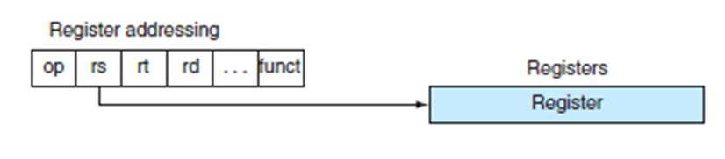
Register Addressing
Destination of an operation is specified by a register

Slide 96
Immediate Addressing
Destination is specified by an immediate value.
Conditional branches specify opcode, two registers, target address
target address is 16 bits
If all addresses had to fit in 16 bits, programs could only be 216 words long.
op
rs
rt
address
6 bits
5 bits
5 bits
16 bits

Slide 97
Base Addressing
Destination is determined by register + branch address

Slide 98
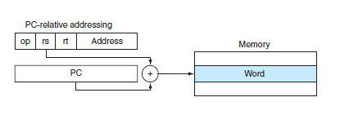
PC-relative Addressing
Destination is determine by PC + offset x 4.
PC (program counter) is the location of our next address.
Conditional branches tend to branch to nearby instructions
Some studies suggest half of all branches go less than 16 instructions away.

Slide 99
PC-relative Addressing
Destination is determine by PC + offset x 4.
If we use PC as the register to be added to the address, our branch range will be 2¹⁵ words in either direction.

Slide 100
Pseudodirect Addressing
Jump-type instructions have 6 bits of opcode and 26 bits for the address.
op
address
6 bits
26 bits

Slide 101
Pseudodirect Addressing
j 10000
PC = PC_{31…28} : (address × 4)
PC = PC_{31…28} : 40000
2
10000
6 bits
26 bits

Slide 102
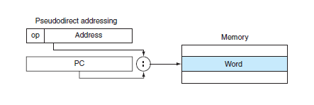
Pseudodirect Addressing
The 26-bit address field is shifted to the left twice
Multiplies by four and creates a 28 bit field
Four most significant bits are copied from the current PC

Slide 103
Target Addressing Example
Loop code from earlier example
Assume Loop at location 80000
Loop: sll $t1, $s3, 2 | 80000 | 0 | 0 | 19 | 9 | 4 | 0
add $t1, $t1, $s6 | 80004 | 0 | 9 | 22 | 9 | 0 | 32
lw $t0, 0($t1) | 80008 | 35 | 9 | 8 | 0
bne $t0, $s5, Exit | 80012 | 5 | 8 | 21 | 2
addi $s3, $s3, 1 | 80016 | 8 | 19 | 19 | 1
j Loop | 80020 | 2 | 20000
Exit: … | 80024

Slide 104
Decoding Machine Language
The first six bits are the opcode
R-type
I-type
J-type
op
rs
rt
rd
shamt
funct
6 bits
5 bits
5 bits
5 bits
5 bits
6 bits
op
rs
rt
constant or address
6 bits
5 bits
5 bits
16 bits
op
address
6 bits
26 bits

Slide 105
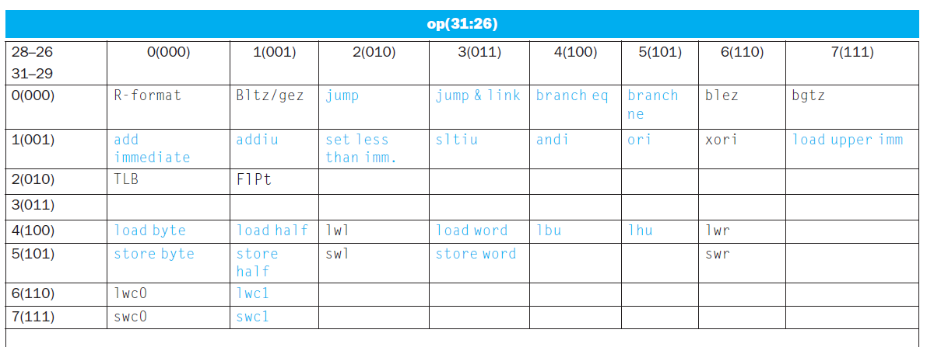
Decoding Machine Language
Based on the opcode:
Bits 31-29 specify row
Bits 28-26 specify column

Slide 106
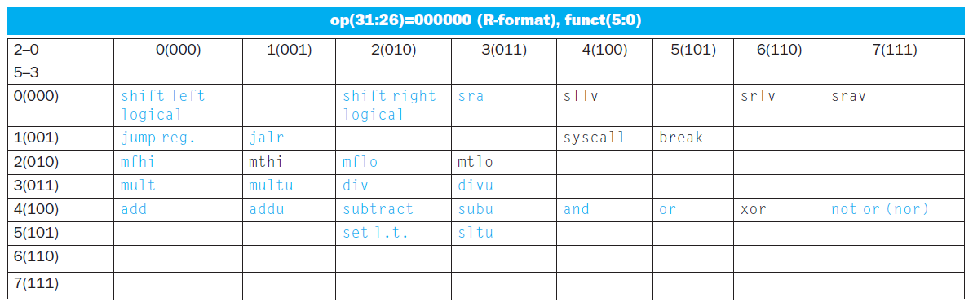
Decoding Machine Language
R-type instructions have an opcode of 000000
Instruction is determined by funct field
Bits 5-3 specify row
Bits 2-0 specify column

Slide 107
MIPS Integer Arithmetic
Instruction Example Meaning Comments
add add $1,$2,$3 $1 = $2 + $3 3 operands; exception possible
subtract sub $1,$2,$3 $1 = $2 – $3 3 operands; exception possible
add immediate addi $1,$2,100 $1 = $2 + 100 + constant; exception possible
add unsigned addu $1,$2,$3 $1 = $2 + $3 3 operands; no exceptions
subtract unsign subu $1,$2,$3 $1 = $2 – $3 3 operands; no exceptions
add imm unsign addiu $1,$2,100 $1 = $2 + 100 + constant; no exceptions
Note: Immediates are sign-extended to form constant for arithmetic operations

Slide 108
MIPS Integer Arithmetic
Why doesn’t MIPS have a subtract immediate instruction?
Negative constants appear much less frequently in C and Java
Since the immediate field holds both negative and positive constants, add immediate with a negative number is equivalent to subtract immediate with a positive number.

Slide 109
MIPS Integer Arithmetic
Instruction Example Meaning Comments
multiply mult $2,$3 Hi, Lo = $2 x $3 64-bit signed product
multiply unsign multu $2,$3 Hi, Lo = $2 x $3 64-bit unsigned product
divide div $2,$3 Lo = $2 ÷ $3, Lo = quotient
Hi = $2 mod $3 Hi = remainder
divide unsign divu $2,$3 Lo = $2 ÷ $3, Unsigned quotient
Hi = $2 mod $3 Unsigned remainder
Move from Hi mfhi $1 $1 = Hi Used to get copy of Hi
Move from Lo mflo $1 $1 = Lo Used to get copy of Lo

Slide 110
MIPS Logical Instructions
Instruction Example Meaning Comment
and and $1,$2,$3 $1 = $2 & $3 Logical AND
or or $1,$2,$3 $1 = $2 | $3 Logical OR
nor $1,$2,$3 $1 = ~($2 |$3) Logical NOR
and immediate andi $1,$2,10 $1 = $2 & 10 Logical AND w. constant
or immediate ori $1,$2,10 $1 = $2 | 10 Logical OR w. constant
shift left log sll $1,$2,10 $1 = $2 << 10 Shift left by constant
shift right log srl $1,$2,10 $1 = $2 >> 10 Shift right by constant
shift left log var sllv $1,$2,$3 $1 = $2 << $3 Shift left by variable
shift right log var srlv $1,$2, $3 $1 = $2 >> $3 Shift right by variable
Note: Immediates are zero-extended to form constant for logical operations

Slide 111
MIPS Load/Store Instructions
Instruction Example Meaning Comments
store word sw $3, 8($4) Mem[$4+8]=$3 Store word
store halfword sh $3, 6($2) Mem[$2+6]=$3 Stores only lower 16 bits
store byte sb $2, 7($3) Mem[$3+7]=$3 Stores only lowest byte
load word lw $1, 8($2) $1=Mem[8+$2] Load word
load halfword lh $1, 6($3) $1=Mem[6+$3] Load half; sign extend
load half unsign lhu $1, 6($3) $1=Mem[6+$3] Load half; zero extend
load byte lb $1, 5($3) $1=Mem[5+$3] Load byte; sign extend
load byte unsign lbu $1, 5($3) $1=Mem[5+$3] Load byte; zero extend
load upper imm lui $1,40 $1 = 40 << 16 Places immediate into upper 16 bits

Slide 112
MIPS Jump/Branch Instructions
Instruction Example Meaning Comments
Branch on equal beq $s1, $s2, l if (s1 == s2), go to L Equal test and branch
Branch on !equal bne $s1, $s2, l if (s1 != s2), go to L Not equal test and branch
jump j 10000 PC = PC:40000 jump to address
jump register jr $31 PC = $31 jump to address in register
jump and link jal 10000 $31 = PC + 4; Save PC next instruction
PC = 40000 jump to address
Notes: Jump destinations are generally specified by a label, not an absolute address. The destination address is word-aligned, so the instruction field is scaled by 4 to create the word address.

Slide 113
MIPS SLT Instructions
Instruction Example Meaning Comments
set less than slt $1,$2,$3 $1 = ($2 < $3) compare signed <
set less than imm slti $1,$2,100 $1 = ($2 < 100) compare signed < constant
set less than uns sltu $1,$2,$3 $1 = ($2 < $3) compare unsigned <
set l. t. imm. uns. sltiu $1,$2,100 $1 = ($2 < 100) compare unsigned < constant

Slide 114
FP Registers
$f1
$f0
°
°
°
$f31
$f30
FP registers are paired for double-precision. Specify the even register, which holds the less-significant word.

Slide 115
MIPS FP Arithmetic
Instruction Example Meaning Comments
FP add single add.s $f2, $f4, $f6 $f2 = $f4 + $f6 Add single precision
FP add double add.d $f2, $f4, $f6 $f2 = $f4 + $f6 Add double precision
FP subtract single sub.s $f2, $f4, $f6 $f2 = $f4 - $f6 Subtract single precision FP subtract double sub.d $f2, $f4, $f6 $f2 = $f4 - $f6 Subtract double precision
FP multiply single mul.s $f2, $f4, $f6 $f2 = $f4*$f6 Multiply single precision
FP multiply double mul.d $f2, $f4, $f6 $f2 = $f4*$f6 Multiply double precision
FP divide single div.s $f2, $f4, $f6 $f2 = $f4/$f6 Divide single precision
FP divide double div.d $f2, $f4, $f6 $f2 = $f4/$f6 Divide double precision

Slide 116
MIPS FP Load/Store
Instruction Example Meaning
Load FP single lwc1 $f1, 100($s2) $f1 = Mem[$s2+100]
Store FP single swc1 $fl, 100($s2) Mem[$s2+100] = $f1
Load FP double ldc1 $f0, 100($s2) $f0 = Mem[$s2+100], $f1 = Mem[$s2+104]
Store FP double sdc1 $f0, 100($s2) Mem[$s2+100] = $f0 Mem[$s2+104] = $f1

Slide 117
MIPS FP Conditional Branch
Instruction Example Meaning
FP Compare single c.lt.s $f1, $f2 if ($f1 < $f2) cond = 1 else cond = 0
FP Compare double c.lt.d $f2, $f4 if ($f2 < $f4) cond = 1 else cond = 0
FP Branch if True bc1t 25 if (cond == 1) go to PC + 4 + 100
FP Branch if False bc1f 25 if (cond == 0) go to PC + 4 + 100
Comparison Instructions: lt may be replaced with eq, ne, le, gt, ge

Slide 118
Sort Example
void sort (int v[], int n) { int i, j; for (i=0; i<n; i++) for (j=i-1; j>= 0 && v[j] > v[j+1]; j--) swap(v, j); }
void swap(int v[], int k) { int temp; temp = v[k]; v[k] = v[k+1]; v[k+1] = temp; }

Slide 119
Translate Swap (Leaf Procedure)
Allocate registers to program variables.
Produce code for the body of the procedure.
Preserve registers across the procedure invocation.

Slide 120
Translate Swap (Leaf Procedure)
Allocate registers to program variables.
void swap(int v[], int k)
Base address of v in $a0
k in $a1
temp in $t0

Slide 121
Translate Swap (Leaf Procedure)
Produce code for the body of the procedure.
swap:
sll $t1, $a1, 2 # $t1 = k * 4
add $t1, $a0, $t1 # $t1 = v+(k*4)
# (address of v[k])
lw $t0, 0($t1) # $t0 (temp) = v[k]
lw $t2, 4($t1) # $t2 = v[k+1]
sw $t2, 0($t1) # v[k] = $t2 (v[k+1])
sw $t0, 4($t1) # v[k+1] = $t0 (temp)
jr $ra # return to calling routine

Slide 122
Translate sort
void sort (int v[], int n) { int i, j; for (i=0; i<n; i++) for (j=i-1; j>= 0 && v[j] > v[j+1]; j--) swap(v, j); }

Slide 123
Translate sort – Outer for loop
for (i=0; i<n; i++)
add $s0, $zero, $zero #initialize i
for1:
slt $t0, $s0, $a1 #reg $t0 = 0 if $s0 >= $a1 (i>=n)
beq $t0, $zero,exit1 #go to exit1 if $s0>=$a1 (i>=n)
…
j for1tst #jump to test of outer loop
exit1:

Slide 124
Translate sort – Inner for loop
for (j=i-1; j>= 0 && v[j] > v[j+1]; j--)
addi $s1, $s0, –1 # j = i – 1
for2:
slti $t0, $s1, 0 # reg $t0 = 1 if $s1 < 0 (j<0)
bne $t0, $zero,exit2 # go to exit2 if $s1<0 (j<0)
sll $t1, $s1,2 # reg $t1 = j * 4
add $t2, $a0,$t1 # reg $t2 = v + (j * 4)
lw $t3, 0($t2) # reg $t3 = v[j]
lw $t4, 4($t2) # reg $t4 = v[j + 1]
slt $t0, $t4, $t3 # reg $t0 = 0 if $t4 >= $t3
beq $t0, $zero,exit2 # go to exit2 if $t4 >= $t3
...
addi $s1, $s1, –1 # j -= 1
j for2 # jump to test of inner loop
exit2:

Slide 125
Translate sort – Calling Swap
Preserve contents of $a0 and $a1
If we have unused registers, storing $a0 and $a1 there will be faster than storing on the stack
add $s2, $a0, $zero # copy parameter $a0 into $s2
add $s3, $a1, $zero # copy parameter $a1 into $s3
add $a0, $s2, $zero # first swap parameter is v
add $a1, $s1, $zero # second swap parameter is j
jal swap

Slide 126
Translate sort – before the loops
Save registers when sort begins
addi $sp,$sp,–20 # make room on stack for 5 regs
sw $ra,16($sp) # save $ra on stack
sw $s3,12($sp) # save $s3 on stack
sw $s2, 8($sp) # save $s2 on stack
sw $s1, 4($sp) # save $s1 on stack
sw $s0, 0($sp) # save $s0 on stack

Slide 127
Translate sort – after the loops
Restore registers when sort ends
lw $s0, 0($sp) # restore $s0 from stack
lw $s1, 4($sp) # restore $s1 from stack
lw $s2, 8($sp) # restore $s2 from stack
lw $s3,12($sp) # restore $s3 from stack
lw $ra,16($sp) # restore $ra from stack
addi $sp,$sp, 20 # restore stack pointer

Slide 128
Translate Sort
sort:
addi $sp,$sp, –20 # make room on stack for 5 registers
sw $ra, 16($sp) # save $ra on stack
sw $s3,12($sp) # save $s3 on stack
sw $s2, 8($sp) # save $s2 on stack
sw $s1, 4($sp) # save $s1 on stack
sw $s0, 0($sp) # save $s0 on stack
add $s2, $a0, $zero # copy parameter $a0 into $s2
add $s3, $a1, $zero # copy parameter $a1 into $s3
add $s0, $zero, $zero # i = s0 = 0
for1:
slt $t0, $s0, $a1 # reg $t0 = 0 if $s0 >= $a1 (i>=n)
beq $t0, $zero,exit1 # go to exit1 if $s0􀁵$a1 (i>=n)
addi $s1, $s0, –1 # j = i – 1
for2:
slti $t0, $s1, 0 # reg $t0 = 1 if $s1 < 0 (j<0)
bne $t0, $zero,exit2 # go to exit2 if $s1<0 (j<0)
sll $t1, $s1,2 # reg $t1 = j * 4
add $t2, $a0,$t1 # reg $t2 = v + (j * 4)
lw $t3, 0($t2) # reg $t3 = v[j]
lw $t4, 4($t2) # reg $t4 = v[j + 1]
slt $t0, $t4, $t3 # reg $t0 = 0 if $t4 >= $t3
beq $t0, $zero,exit2 # go to exit2 if $t4 >= $t3
add $a0, $s2, $zero # first swap parameter is v
add $a1, $s1, $zero # second swap parameter is j
jal swap
addi $s1, $s1, –1 # j -= 1
j for2 # jump to test of inner loop
exit2:
addi $s0, $s0, 1 # i += 1
j for1t # jump to test of outer loop
exit1:
lw $s0, 0($sp) # restore $s0 from stack
lw $s1, 4($sp) # restore $s1 from stack
lw $s2, 8($sp) # restore $s2 from stack
lw $s3,12($sp) # restore $s3 from stack
lw $ra,16($sp) # restore $ra from stack
addi $sp,$sp, 20 # restore stack pointer
jr $ra # return to calling routine

Slide 129
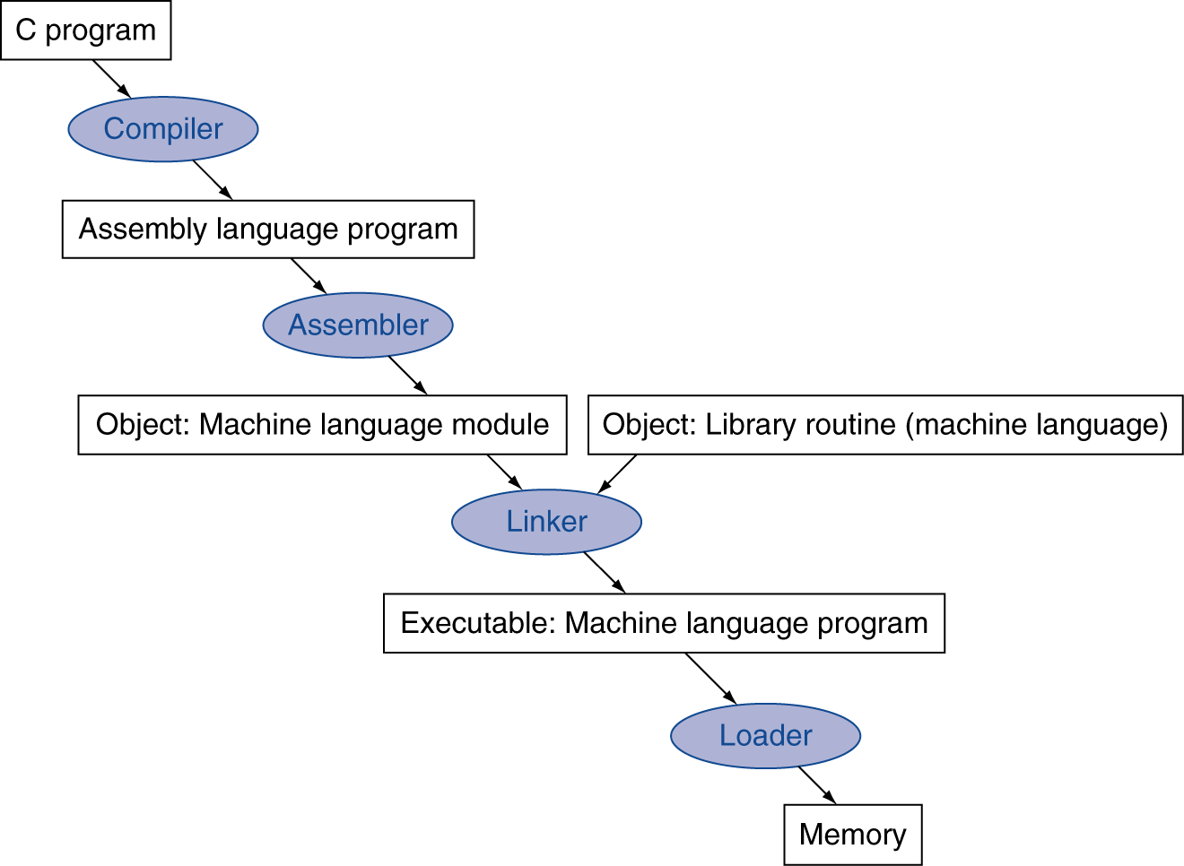
Translation and Startup
Many compilers produce object modules directly
Static linking

Slide 130
Step 1: Compiling
A compiler transforms a high-level language into assembly instructions and pseudoinstructions
High level languages use fewer lines of code
Modern programmer productivity is higher
Modern compilers are better at optimizing assembly language

Slide 131
Assembler Pseudoinstructions
Pseudoinstructions: common variation of assembly language instructions
move $t0, $t1 → add $t0, $zero, $t1
blt $t0, $t1, L → slt $at, $t0, $t1 bne $at, $zero, L

Slide 132
Step 2: Assembly
resolve labels on instructions and data:
relative to PC for instructions
relative to some register for data
either two-pass or use backpatch to resolve external references and PC-relative spans
expand any macros and pseudoinstructions
handle any assembler directives: data layout
translate instructions to binary
create object file:
headers
code segment (called text in Unix)
data segment
relocation information: instruction/data words to relocate
symbol table: unresolved references + visible symbols
debugging information

Slide 133
Step 3: Linking
Standard library routines are often not recompiled
The linker will use the already compiled version
Place code and data modules symbolically in memory.
Determine the addresses of data and instruction labels.
Patch both the internal and external references.
The result is an executable file with no unresolved references.

Slide 134
Step 4: Loading
reads executable
loads code and data segments
initializes registers, stack, and arguments
jumps to program’s start-up routine to initiate execution

Slide 135
Dynamic Linking
Static Linking Advantage
fastest method to call library routines
Static Linking Disadvantages
Routines become part of the executable code
Updating is more difficult
The whole library must be loaded
Dynamic linking postpones loading and linking library routines until the program is run.
Very slow the first time the routine is called

Slide 136
Summary - MIPS
32 general purpose registers
Software conventions assign properties to registers
32-bit wide instructions
3 formats: R-type, I-type, J-type
Machine code: binary or hexadecimal
Reduced Instruction Set
Operations: Arithmetic, Logical, Data Transfer, Conditional

Slide 137
Summary – Design Issues
Simplicity favors regularity. Regularity motivates many features of the MIPS instruction set: keeping all instructions a single size, always requiring three register operands in arithmetic instructions, and keeping the register fields in the same place in each instruction format.
Smaller is faster. The desire for speed is the reason that MIPS has 32 registers rather than many more.

Slide 138
Summary – Design Issues
Make the common case fast. Examples of making the common MIPS case fast include PC-relative addressing for conditional branches and immediate addressing for constant operands.
Good design demands good compromises. One MIPS example was the compromise between providing for larger addresses and constants in instructions and keeping all instructions the same length.

Slide 139
MIPS-64
Extension of MIPS-32
Specifies 32 64-bit registers
Instructions remain 32-bits wide

Slide 140
MIPS-64
Load 64-bit Integer LD
Store 64-bit Integer SD
Add 64-bit integers DADD
Subtract 64-bit integers DSUB
Mult. 64-bit integers DMULT
Divide 64-bit integers DDIV
64-bit shifts DSLL, DSRL

